Slide 1




Neo life

Slide 2


Team
1
Abdelrahman Mohamed Ramadan
Ali Ahmed Ali
Anas Sayed Ahmed
Eman Abderabuh Hamed
4
2
5
Fatma Mohamed Hassan
3
6
Yousef Mohamed Sameeh

Slide 3
In This Presentation
1
Project Overview
Neolife Logo Analysis
Software Used for Implementation
Target Audience and Their Needs
Preparation Plan for Project Implementation
Elements to Be Implemented in the Project
Challenges Faced During Execution
Solutions Reached
6
2
7
3
8
4
5

Slide 4

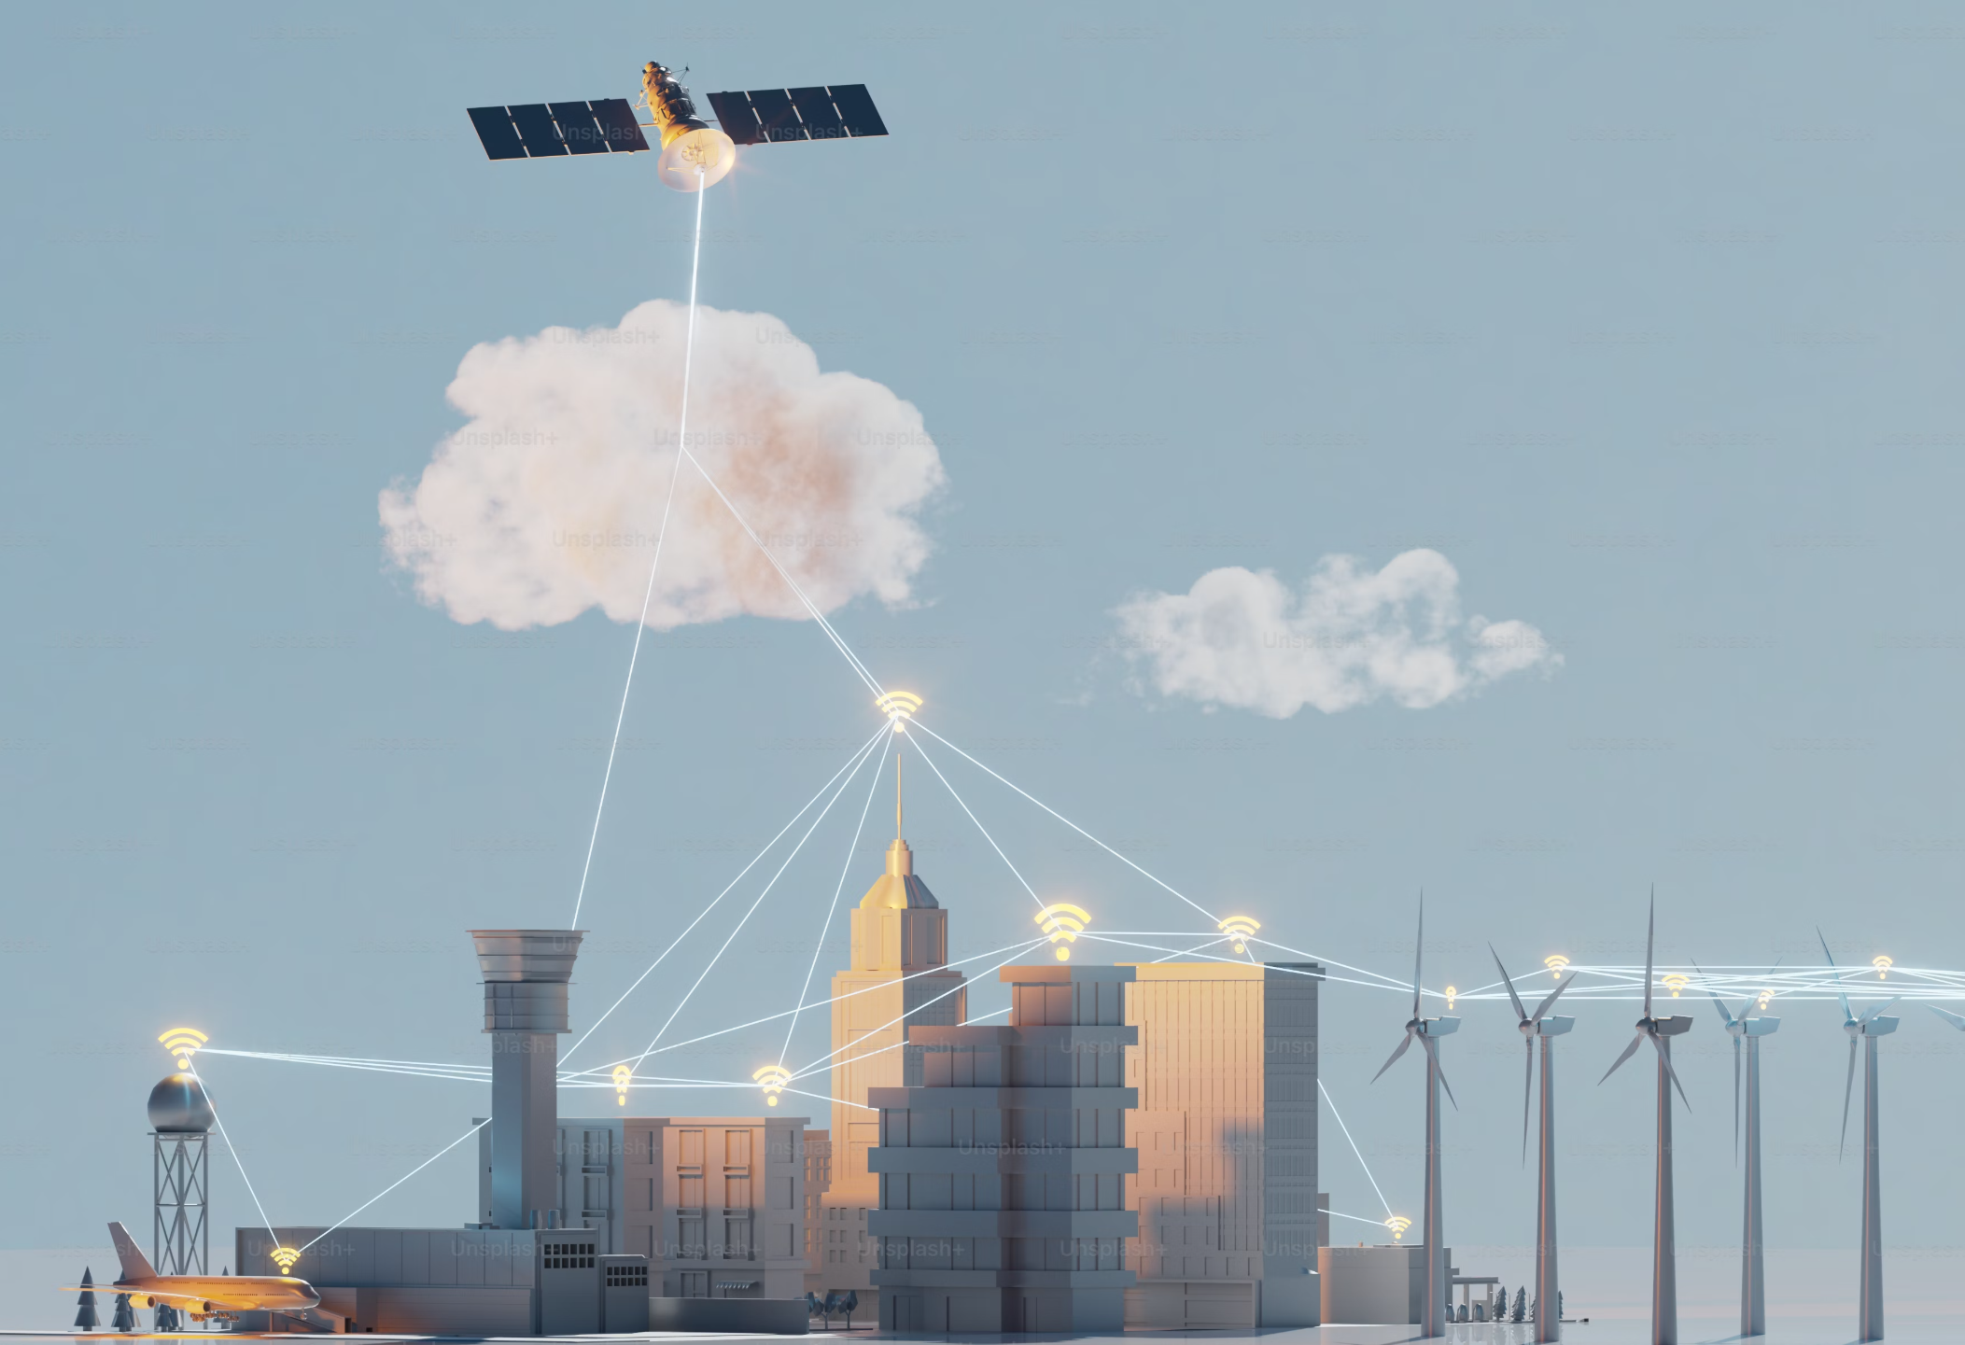
Project Overview
Neolife is a real estate project aimed at building a fully AI-powered city while preserving the environment and utilizing solar energy as the primary power source.

Slide 5



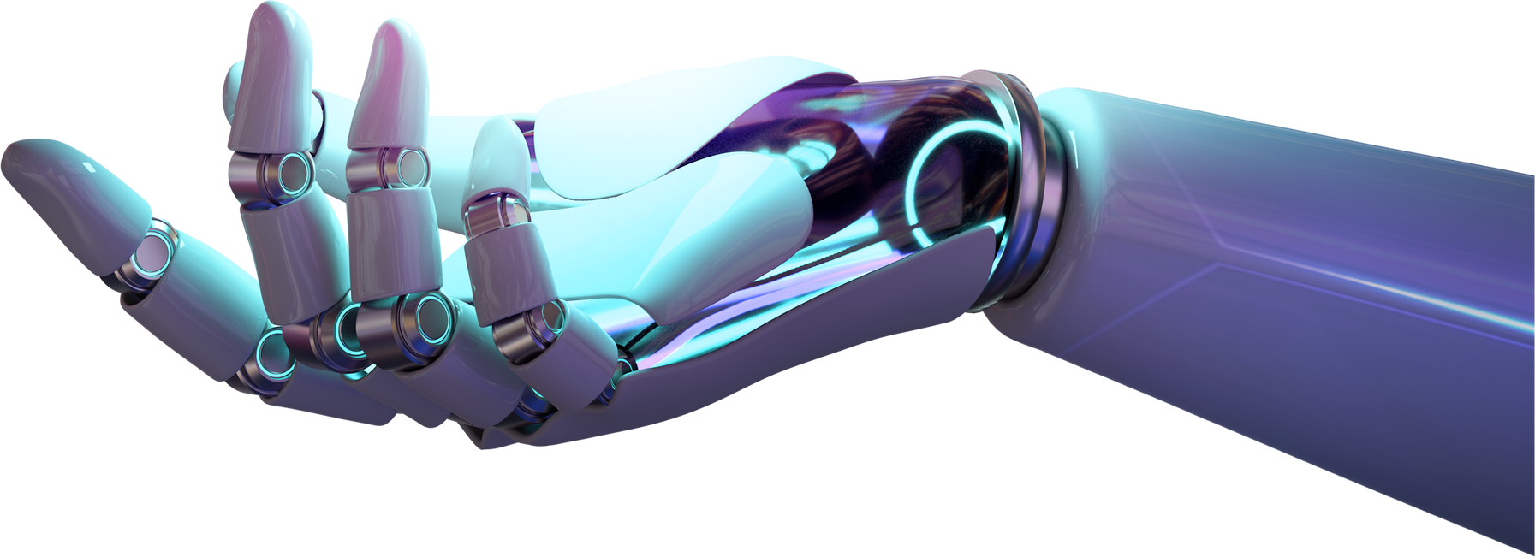
Project Overview
Vision
To build a smart, sustainable city powered by AI and solar energy, enhancing modern living while preserving the environment.
Mission
“To develop an integrated city that utilizes AI and renewable energy, ensuring sustainability and a balance between technology and nature.’’

Slide 6
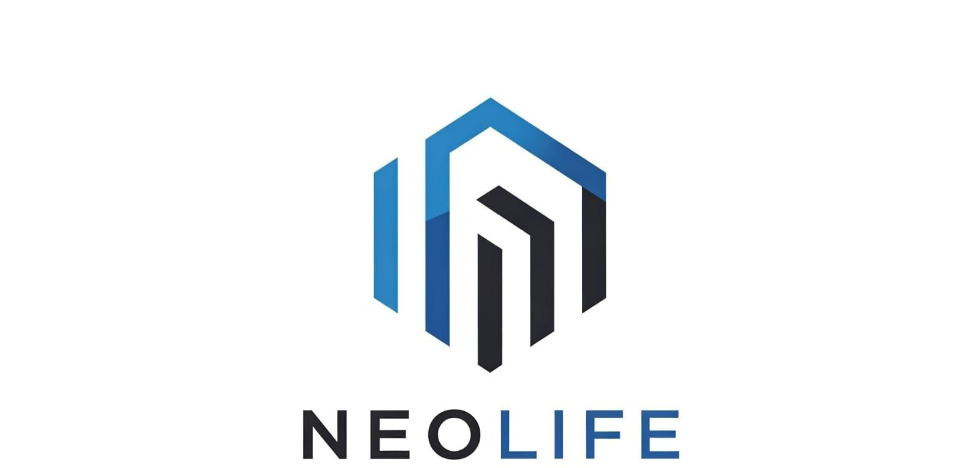
Neolife Logo Analysis
The Neolife logo consists of elements that reflect the concept of a smart and sustainable city:
Geometric Shape: Represents modern and futuristic infrastructure.
Blue and Black Colors: Blue symbolizes technology and progress, while black represents strength and sustainability.

Slide 7

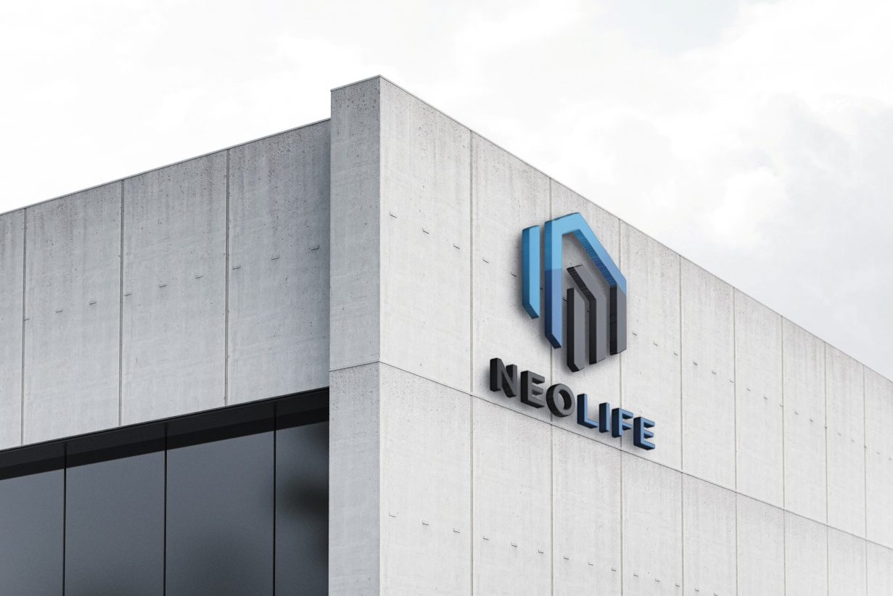
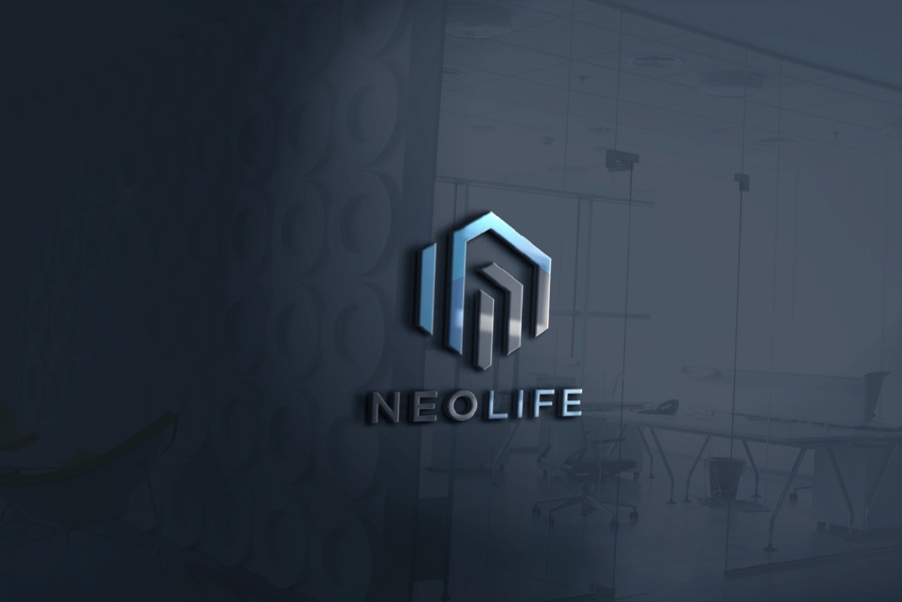
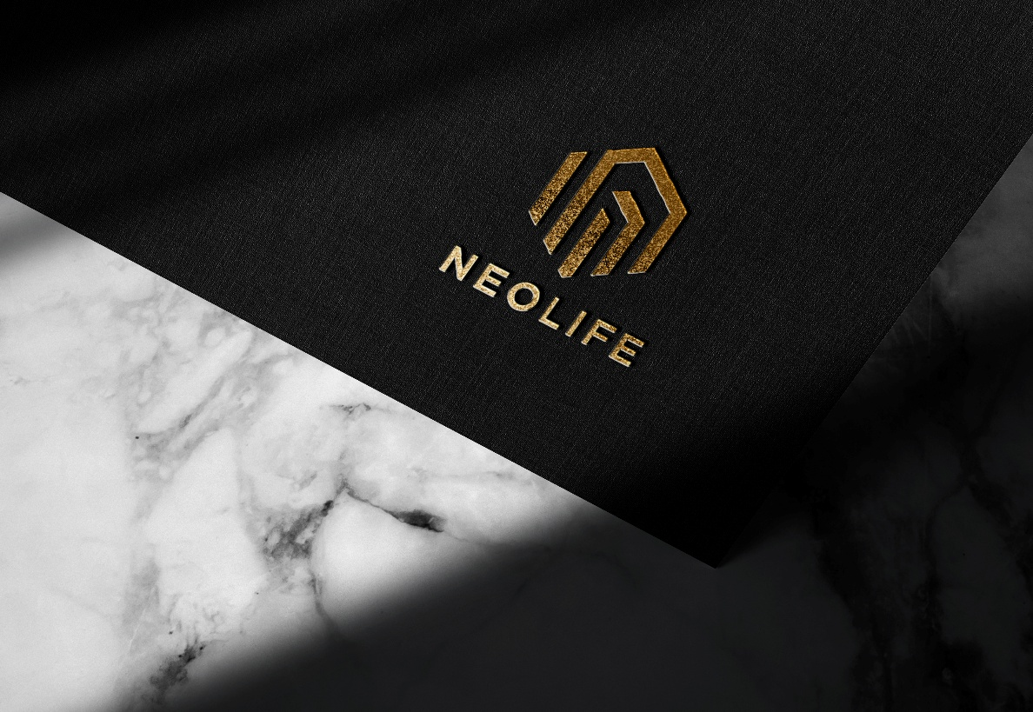
Logo Mokups

Slide 8



Software Used for Implementation
Adobe Photoshop
Adobe Illustrator
Adobe Indesign

Slide 9

Target Audience and Their Needs:
Businessmen and Investors
Seeking investment opportunities in smart and sustainable cities.
Modern Families
Ensuring the well-being of passengers and pedestrians
Government Entities
Commitment to eco-friendly practices

Slide 10



Preparation Plan for Project Implementation
Market research and competitor analysis.
Initial planning for the city's infrastructure.
Designing the project's visual identity.
Preparing marketing materials.
Developing an execution plan to kickstart the project.

Slide 11
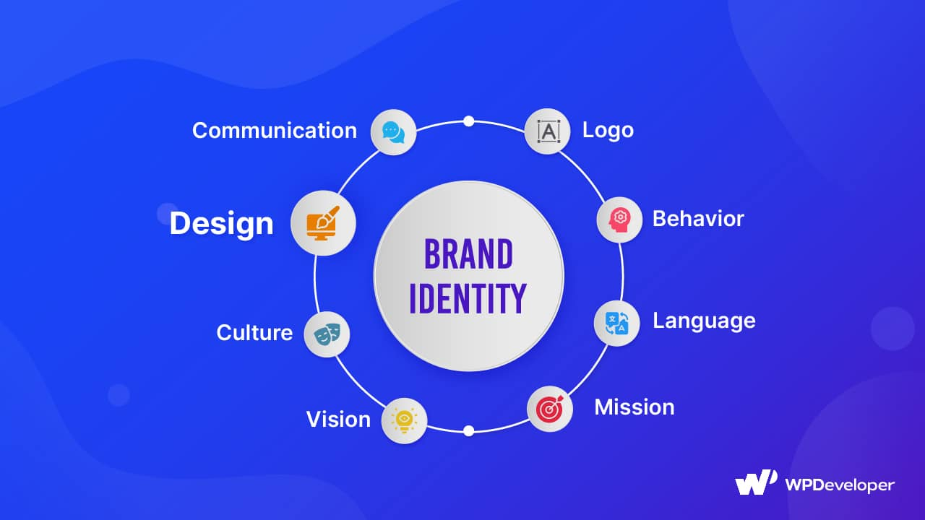
Elements to Be Implemented in the Project:
Designing the full visual identity of the project.
Creating marketing and advertising materials.
Designing logos and printed materials related to the project.
Developing visual and graphic content for the project

Slide 12
Challenges Faced During Execution
•Defining a visual identity that reflects the concept of a smart and sustainable city.
•Selecting appropriate colors and typography that represent technology and sustainability.
•Organizing teamwork among members to achieve a unified vision.

Slide 13
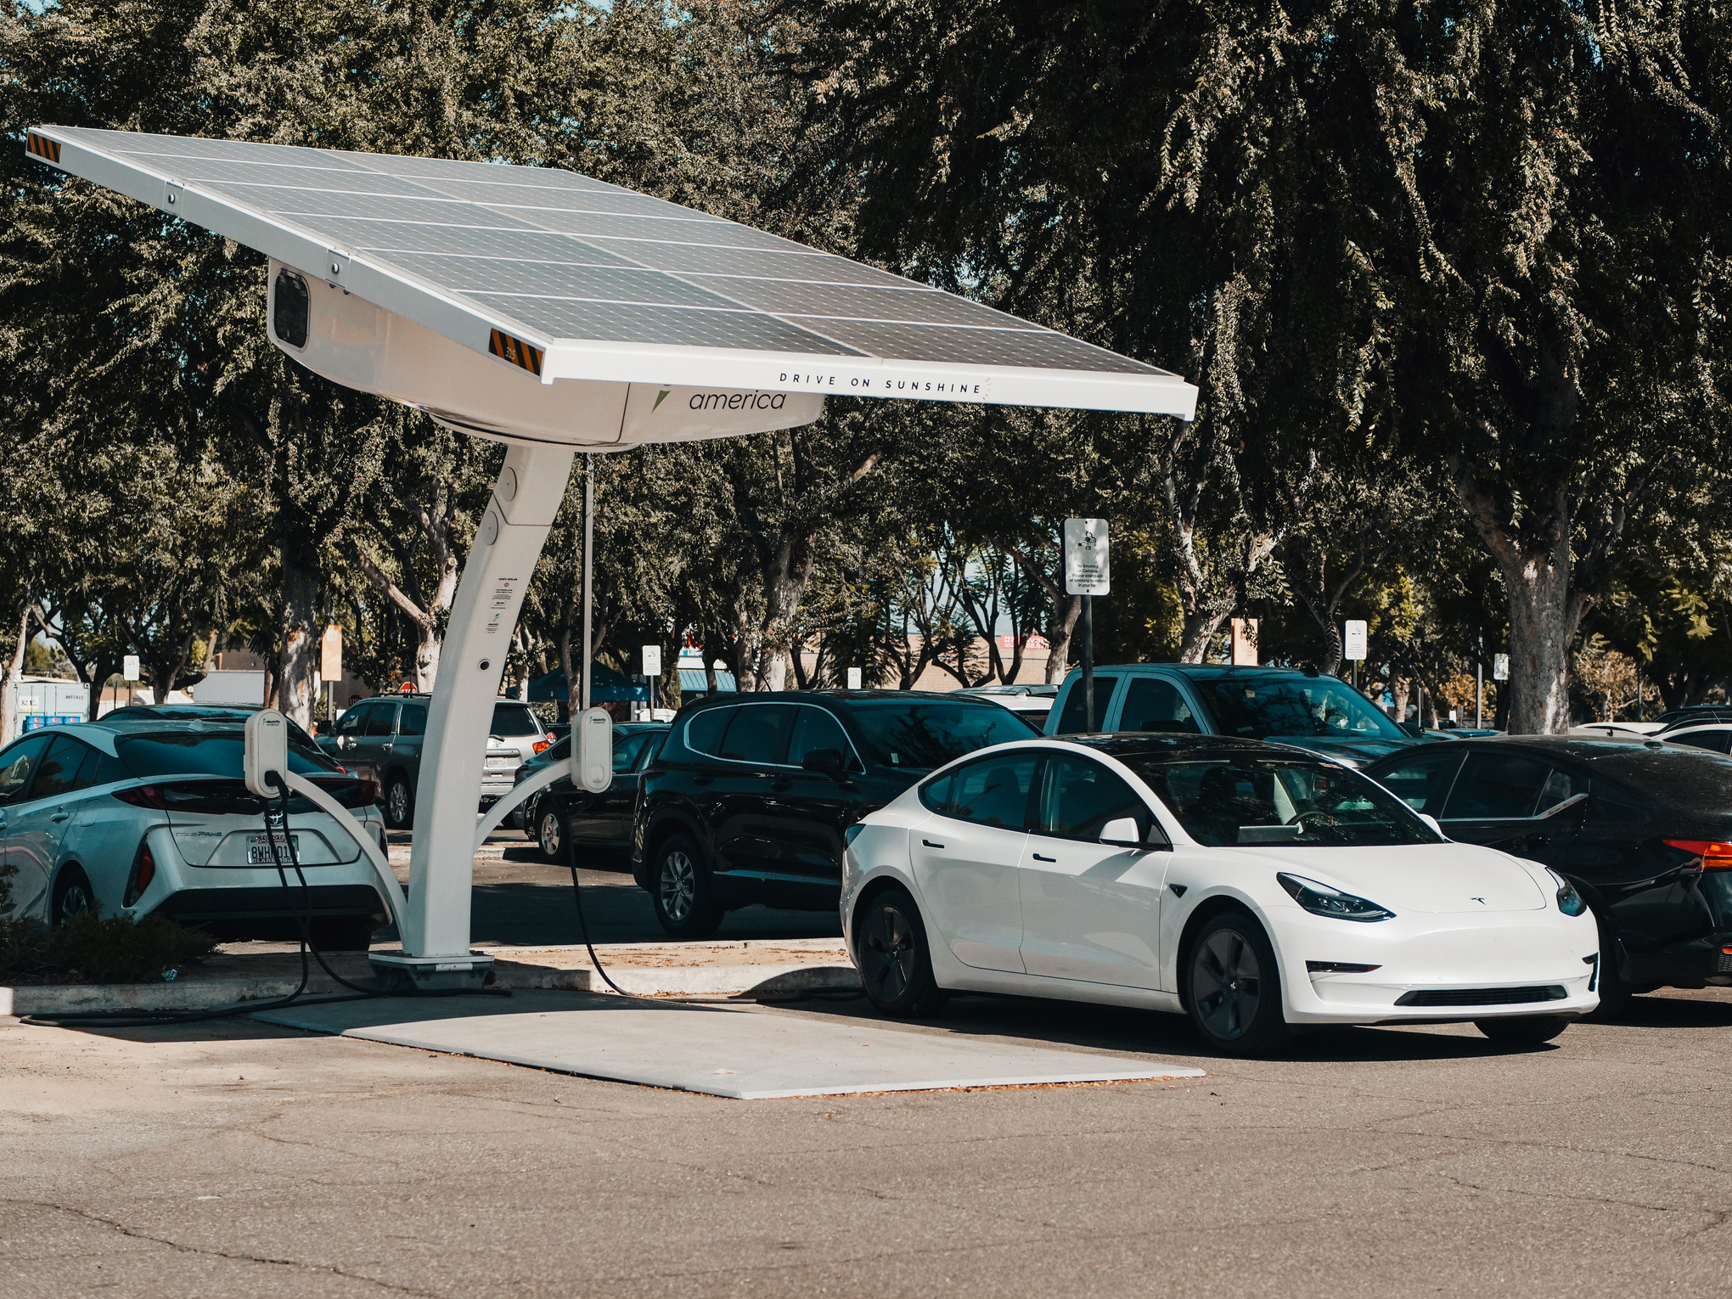
Solutions Reached
Conducting extensive research on modern designs and smart cities.
Using colors and typography that represent modernity, technology, and sustainability.
Clearly distributing tasks among team members to ensure higher productivity.

Slide 14
THANK YOU

